Slide 1

FINTECH PROBLEM STATEMENT- 1
Title: Mobile Game for Personal Finance Education and Investment
Team No-42
Team Name-The Vikkings
Team Members-
Sumit Kumar
Preet Kumar
Ramkishan gupta
Gaurav Rawat

Slide 2
Problem Statement
Solution
Children often struggle to engage with traditional personal finance education, which limits their understanding of essential concepts like saving, investing, and money management. This gap can lead to poor financial habits in the future. The challenge is to create an interactive solution that makes learning about personal finance both enjoyable and educational. This solution, whether a game, app, or other platform, should cater to children and provide them with real-world financial tools to practice saving and investing in a fun, accessible manner. The goal is to foster early financial literacy and responsible money habits.
Little Bankers is an interactive web game designed to engage children in learning personal finance through exciting, hands-on experiences. The game includes adventures like Stock Market Adventure, where players learn about investing by making virtual trades and observing market fluctuations. In Global Currency Adventure, children explore different world currencies and understand exchange rates in a fun, educational setting. Additionally, Guess Me challenges players' financial knowledge through a guessing game, making the process of learning about money management, saving, and investing both fun and interactive
Unique selling points
Little Bankers stands out by offering real-world financial learning through interactive gameplay, allowing children to experience scenarios like stock trading and currency exchange in a fun, engaging way. With adventures like Stock Market Adventure and Global Currency Adventure, players are introduced to global financial systems, making complex concepts easy to grasp through hands-on activities. Additionally, the game blends education with fun by offering a variety of challenges, including mini-games like Guess Me, ensuring that kids enjoy learning key financial skills in an interactive and memorable format.

Slide 3
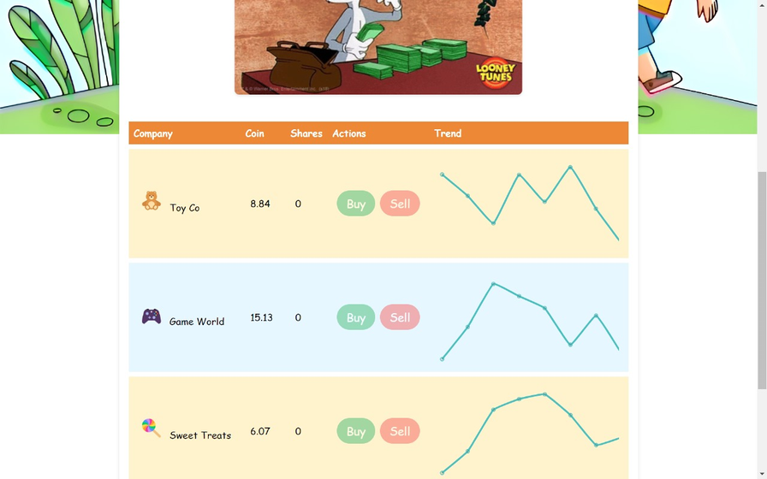
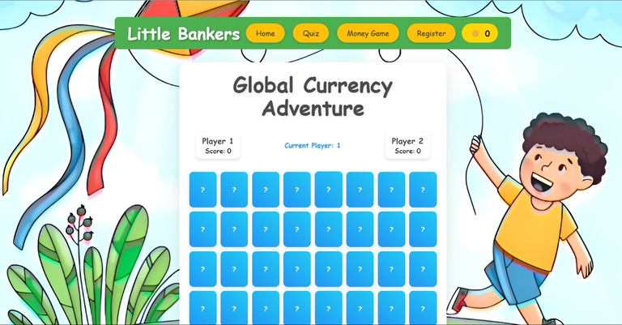


Tech Stack and Product
•This project will be built by using MERN stack
•For Backend :-
NodeJs, ExpressJs, REST APIs
•For Frontend:-
CSS Tailwind , ReactJs
•For Database:-
FireBase

